Slide 1
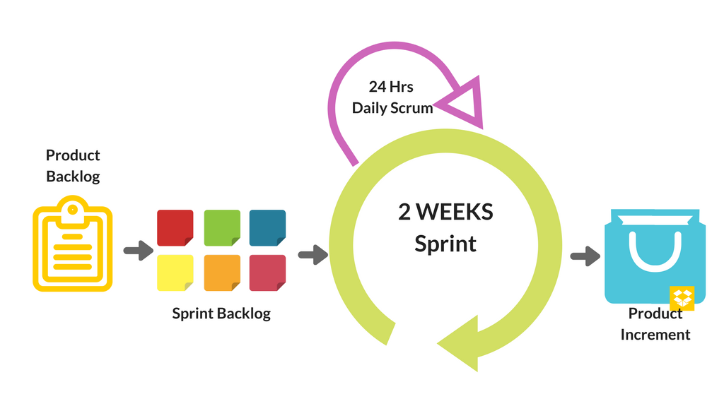
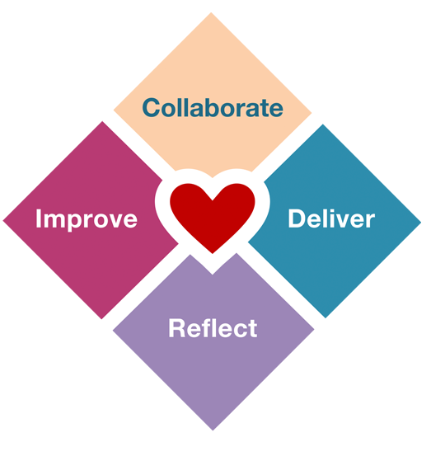
Scrum-Agile
ChadaTech Presentation by Tabitha Pawlowski

Slide 2
The scrum-agile approach
The scrum-agile approach is a methodology for software design and other project management processes that emphasizes the encouragement of change and transition throughout a project's lifecycle. The framework includes a team of several people that collaborate to maintain constant progress and rapidly produce working deliverables to the client. Agile involves many principles and core values that together create an environment that leads to the ability to produce quality results quickly (Cobb, 2015).
Scrum values Agile principles
Commitment and focus
Openness
Respect
Courage
(Cobb, 2015, pp. 44-54)
Build Quality into Product
Emphasize on Human Aspect of Quality
Need for Cross-functional Collaboration
Importance of Leadership
Continuous Improvement
Focus on Customer Value
Map the Value Stream
Pull vs. Push
Importance of Flow
Respect for People
Perfection

Slide 3
Roles of a scrum-agile team
Scrum Master
The Scrum Master is a servant-leader for their team that ensures all scrum practices are enacted. They ensure that everyone understands how scrum will be used and help guide the team through any obstacles and setbacks. The Scrum Master facilitates scrum events such as daily stand-ups and retrospectives, as well as making sure everyone is comfortable working with one another. Lastly, the Scrum Master is responsible for educating stakeholders and company executives on scrum practices.
Product Owner
The main responsibility of the Product Owner is to maximize the quality of work done by the team. To do this, the Product Owner is the primary translator between the team and client and communicates all the client's needs and wants. They organize these requests in a product backlog that helps the team prioritize and focus on the most important tasks first. The Product Owner makes final decisions for the team and is the ultimate team-guide for what the end-result should be.
Developer
The development team consists of people who are the ones that actually create the product that will be delivered to the client. They must create their own definition of "done" to describe the point where their work can be presented to their client. Although members of the team may have unique and specialized skill sets, developers are expected to work together to create a functional product of the highest quality. There should be no sub-teams or groups within the development team.
Product Tester
Product Testers are responsible for ensuring the product exceeds all the expectations of the client. They work closely with the Product Owner and development team to define and understand user requests, as well as concentrate on how the team can address these requests easily and quickly with high quality solutions. Product testers recognize and give feedback on how to solve issues within the product. Their main goal is to ensure functionality is maintained throughout the process.
Cobb, 2015, pp. 35 – 38 LinkedIn, 2024

Slide 4
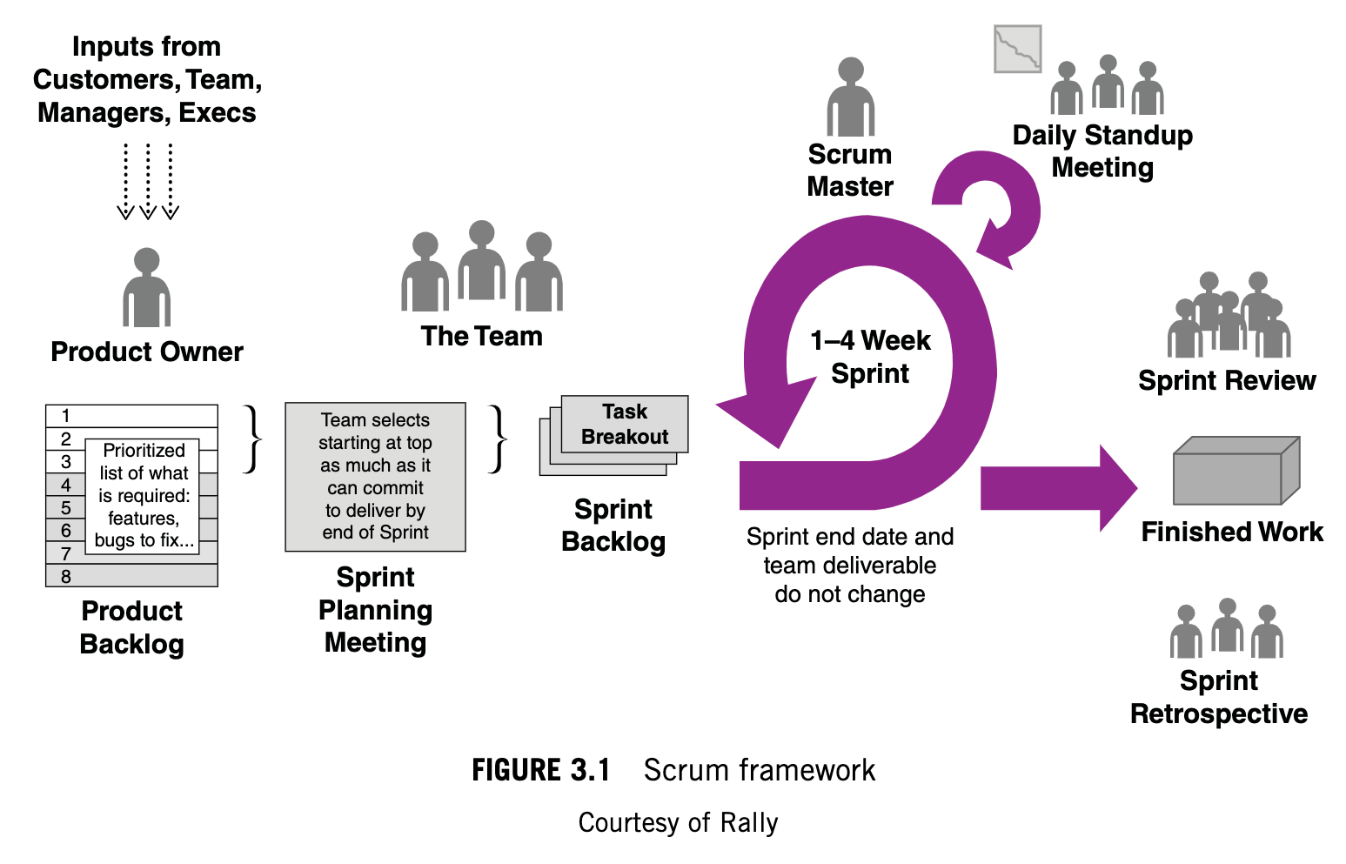
Phases of the software development life cycle through agile
Product Backlog: The project usually begins with a meeting between the client, stakeholders, Product Owner, and other various team members to discuss the expectations, requirements, and details of the proposed project. The team tries to get as much specification about the product from the client so that they are all on the same page. The Product Owner takes these user requests, or stories, and inputs them into an organized product backlog based on importance for the rest of the team to view throughout the project's lifecycle. This backlog serves as a continual reminder of what the team's main focus should be on at all points during the sprint.
Sprint Planning Meeting: Once the team knows what is expected of them, they can consider how they are going to go about meeting those expectations. Part of this process includes planning what order work should be done in to maximize the team's efficiency. Each sprint, the team has a certain set of tasks to accomplish before being able to present a working deliverable to the client. It is during the sprint planning meeting that the team discusses what finished
work they will be able to promise to the client and start considering how they should
go about completing that work.
Sprint: The sprint is a decided-upon time interval, usually around two to four weeks,
where the team's goal is to complete all the work that they have promised to have
complete by their own definition of "done". Usually no new work is added during a
sprint as to ensure that all previously promised work is accomplished. It is very
important in an Agile environment that the goal of each sprint is accomplished
in the set time frame and that the goals and time frames are never changed after a
sprint has already begun.

Slide 5
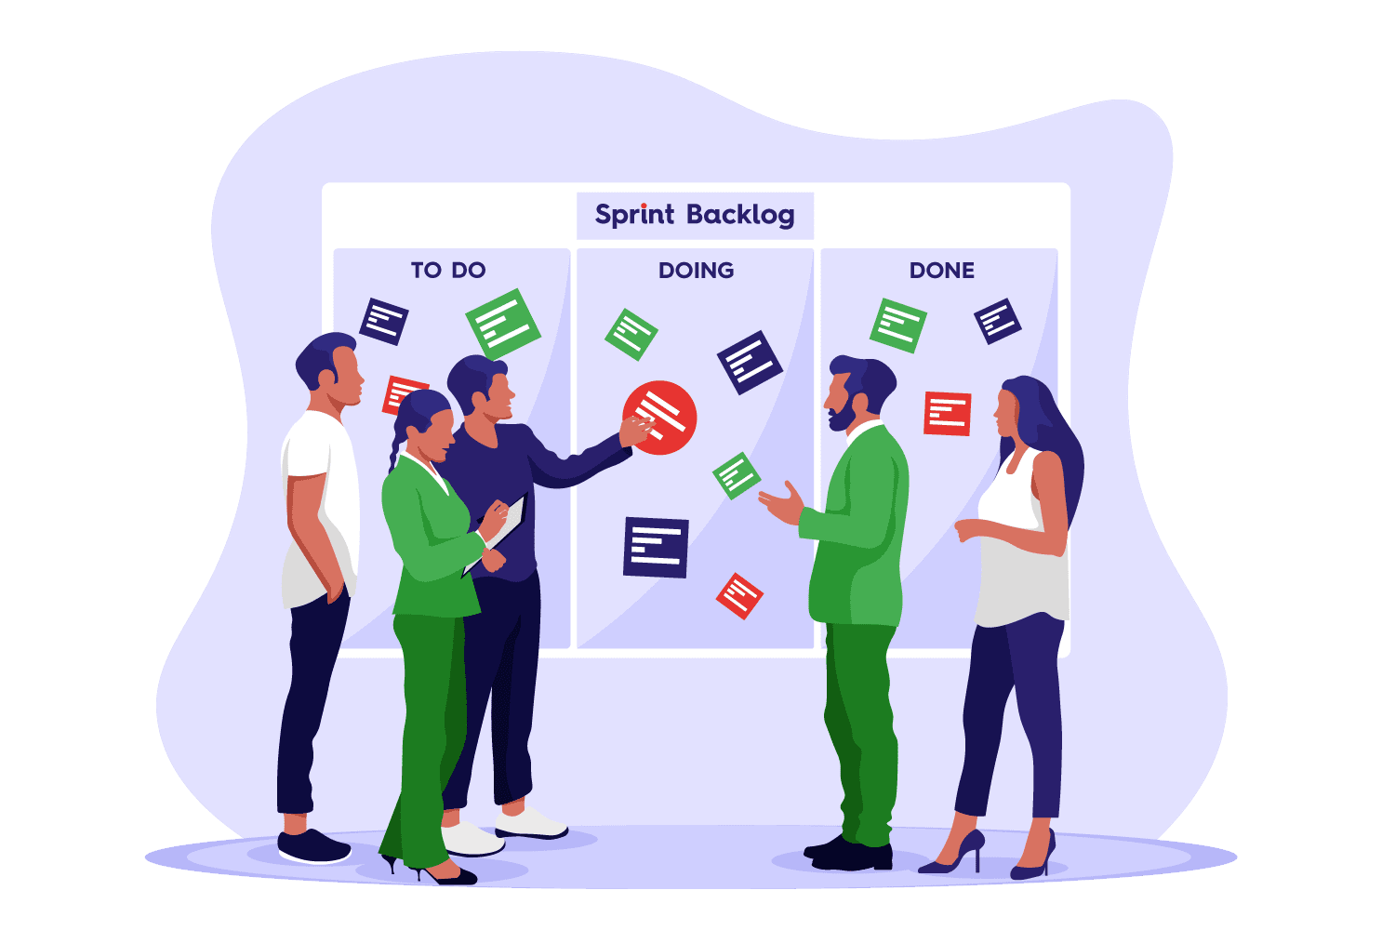
Phases of the software development life cycle through agile... Continued
Daily Stand-Ups: Daily Stand-Ups serve as a time where team members can collaborate with one another and share their ideas or concerns with the progress being made. The Daily Stand-Ups are usually a 10-to-20-minute meeting done at the beginning or end of the day meant to be a quick and relaxed setting where members can share questions or feedback. This helps create an environment of familiarity and comfortability, easing the way to the sharing of ideas or hindrances and ultimately leading to higher quality results. The three main questions for everyone to answer during a stand-up are: 1. What did you accomplish yesterday? 2. What are you going to accomplish today? And, 3. What obstacles are stopping you from accomplishing those things? It is called a Daily "Stand-Up" since participants usually stand during the meeting to reinforce their quick nature.
Sprint Review and Retrospective: At the end of a sprint, after the team has given their final product to the Product Owner to send off to the client, the Scrum Master holds a sprint review or retrospective to recap the progress made and go over the results of the project. It is during this point that the team members can reflect on their times,
both good and bad, and consider what would benefit them the most next time.
When thinking about any obstacles or advantages, they allow themselves to improve
for next time by considering what to do again, or what to change. Retrospectives
usually occur at the end of each sprint. Since sprints are only a few weeks long,
Agile allows individuals to make rapid reflection, which often leads to consistent
and fast improvement.
(Cobb, 2015, pp. 39 - 44).

Slide 6
Agile vs. waterfall
Agile allows for much more flexibility and adaptation when it comes to software development. In our particular project with SNHU Travel, there were several changes that an agile approach helped us to address. For example, we began the project by suggesting vacation packages based on a user's previous travel experiences. However, as the company completed more research, they found that wellness packages were becoming more popular and wanted to join the trend. The company asked us to instead suggest vacations related to wellness and healthy living styles. Agile encourages change and using this approach helped our team navigate these transitions. In addition, agile emphasizes rapidly producing quality results. By using Agile methods, such as timeboxing and sprints, we were able to give SNHU Travel functional deliverables in just a few short weeks.
A more traditional development approach, such as the waterfall method, would have had some shortfalls when it came to addressing obstacles and changes. Waterfall emphasizes a sequential order where one task cannot begin until all previous tasks have been completed. This leads to issues when changes are requested that force the team to go back and fix things that have already been "completed." During our time working on the SNHU Travel Project, we had to go back and change previously submitted progress at several points, such as when we had to change what type of vacations to suggest to users. In a waterfall project, going back causes a major disruption to the order of focus and can lead to major schedule and cost conflicts. Agile, on the other hand, encourages adaptation, leading to a much better approach when it comes to projects with less than perfect predictability.

Slide 7
If we used waterfall
The process of work and the end results of our project would have been much different if we used a waterfall method over the course of the sprint instead of an agile approach. For instance, the project could have taken a longer time to accomplish without the agile principles of timeboxing and accomplishing all designated work per sprint. In addition, with a waterfall approach, going back and making those requested changes would have been nearly impossible. If we had been able to make those changes, it would have certainly added to the schedule and cost of the project. As a team, we would have also had to put an emphasis on tools and processes over individuals and interactions. With agile, we had daily-stand ups, sprint reviews, and in-person project planning meetings that helped strengthen our comprehension of the requirements and create a community of individuals who felt comfortable enough to work with each other. A waterfall method would have forced us to complete extensive documentation, taking away from these crucial person-to-person interactions. Waterfall is an effective approach during a short-term project when predictability is high and there are not many uncertainties. However, pertaining to the SNHU Travel project, agile was a much more effective method to use.

Slide 8
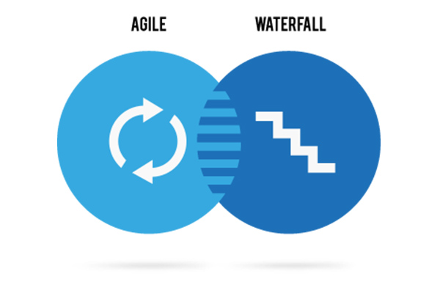
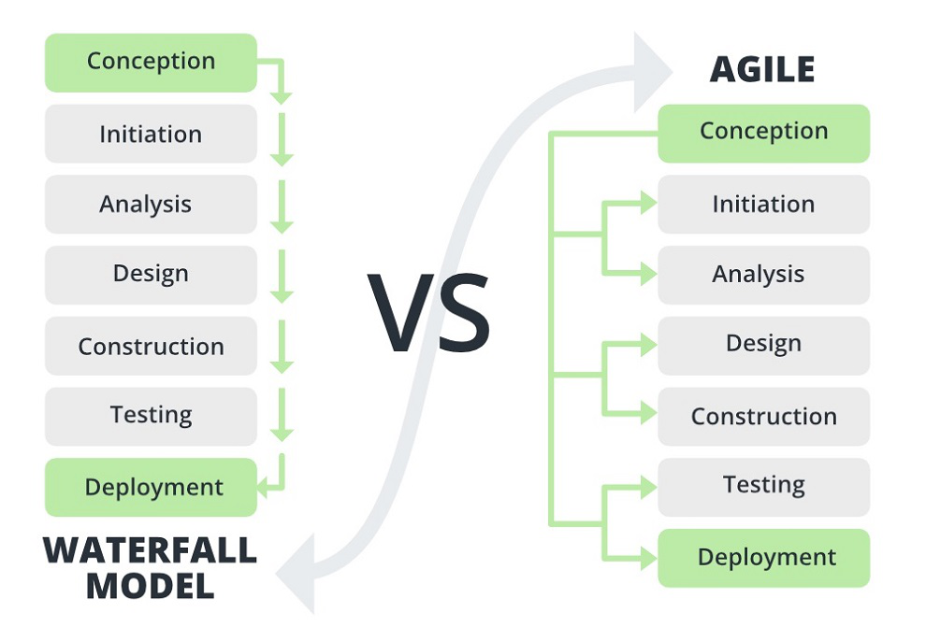
How to choose between waterfall and agile
Short or Long Term
Long term projects tend to have more uncertainty and a higher chance of changes being made throughout the lifecycle. This could lead to issues when trying to use a waterfall method, so waterfall should be reserved for more short-term projects.
The SNHU Travel project was only a few short weeks, but still consisted of several changes throughout its lifecycle. A longer project is more prone to changes, and an agile approach is better equipped to handle these situations.
How Much Pre-Planning is Necessary
The waterfall method requires that project requirements are detailed from the very beginning. If you know all of the requirements and details of the project before beginning, waterfall could be a good method for ensuring those requests are met. However, if not much detail is known before starting, then an agile approach is most likely going to work better for that specific project.
During the SNHU Travel project, the SNHU Travel company kept conducting continual research, even after the team began developing their product. Since all the details were not known from the very beginning, an agile approach was more beneficial.
Is Speed a Priority
Many factors can slow down the progress of a waterfall project, such as bottlenecks with QA testers, stakeholder acceptance, and prior user story completion. In an agile project, practices like sprints and timeboxing are enforced to create a fast-paced environment with functional deliverables being produced regularly. If a major goal is rapid production, then waterfall may not be the most effective approach for that project.
We only had a few short weeks to complete the SNHU Travel project. By sticking to our sprint timelines and timeboxing our deliverables to only have about a week to be worked on, we were able to meet these quick deadlines and produce fast-paced, working products.

Slide 9
References
https://www.linkedin.com/advice/0/what-roles-responsibilities-testers-scrum-skills-scrum#:~:text=In%20Scrum%2C%20testers%20are%20not%20only%20responsible%20for%20finding%20and,criteria%2C%20and%20definition%20of%20done.%E2%80%8B%E2%80%8B
Charles G. Cobb. (2015). The Project Manager’s Guide to Mastering Agile : Principles and Practices for an Adaptive Approach. Wiley. https://web-p-ebscohost-com.ezproxy.snhu.edu/ehost/ebookviewer/ebook/bmxlYmtfXzkzNzAwOV9fQU41?sid=96fcd163-5101-4b25-b0b9-3e255259a013@redis&vid=0&format=EB&rid=1
​
Muyambo, T., & Kaur, M. (2024, February 8). What are the roles and responsibilities of testers in Scrum?. LinkedIn.
Charles G. Cobb. (2015). The Project Manager’s Guide to Mastering Agile : Principles and Practices for an Adaptive

